Slide 1
Introduction to
IT Project Management
Dr. Alshaimaa Ramdan
Teaching Assistants:
Salwa Megahed
Sherrie Kareem
Rana Alaaeldin
Spring Semester 2018
Page 1
IT Project Management-Tutorial 1

Slide 2
Contact Information
TAs: Rana Alaaeldin
Salwa Megahed
Sherrie Kareem
Email:
Salwa.megahed@guc.edu.eg
Rana.muhammed@guc.edu.eg
Sherrie.kareem@guc.edu.eg
Room: B1.322
Office Hours: By appointment
Course Content Material: Intranet\Faculties\Management Technology\MGT for other faculties\IT Project Management.
Page 2
IT Project Management-Tutorial 1

Slide 3


Slide 4
Attributes
PMO
Project
ITPM
Knowledge Area
Project Management Framework
Skills and Competencies
Project Manager
Page 2
IT Project Management-Tutorial 1

Slide 5
What Is a Project?
A project is “a temporary endeavor undertaken to create a unique product, service, or result” (PMBOK® Guide, 5th Edition, 2012)

Slide 6
What is Project Management?
Project management is “the application of knowledge, skills, tools and techniques to project activities to meet project requirements” (PMBOK® Guide, 5th Edition, 2012)

Slide 7
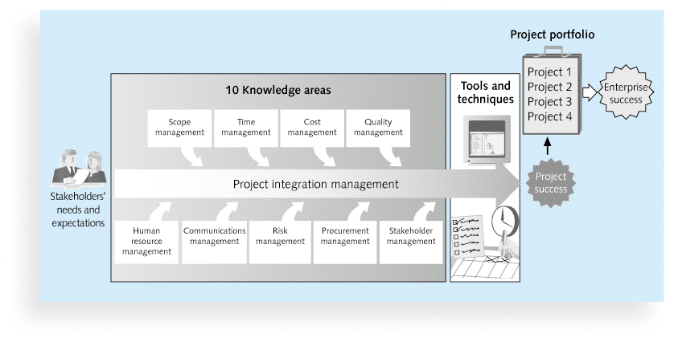
Project Management Framework

Slide 8

Activity
Read the case
“Overseas-China Banking Corporation Spearheads: A Masterful Systems Conversion”
Page 5
IT Project Management-Tutorial 1

Slide 9
Discussion:
Identify the project.
Who should be responsible for all these tasks?!! To what extent?
What are the Success factors for the OCBC cut-over?
IT Project Management-Tutorial 1

Slide 10
Assessment Criteria for BI/IS
Weight of Final Grade | Evaluation
40 % | Final Exam
20 % | Mid Term Exam
10 % | Project (group 4-5) Presentation
20 % | Project - Individual Report
10 % | Assignments (2)
100 % | Total
IT Project Management-Tutorial 1

Slide 11
Assessment Criteria for Engineering (CSEN and DMET)
Weight of Final Grade | Evaluation
50 % | Final Exam
20 % | Mid Term Exam
15 % | Project (group 4-5) Presentation
15 % | Assignments (2/3)
100 % | Total
IT Project Management-Tutorial 1

Slide 12
Thank you ☺

